Slide 1
WIS, Inc.™
KLA-Tencor Legacy Tools Support
Argon Lasers
Solid State Lasers
Calibration Standards/wafers/reticles
508-944-2851 www.waferinspectionservices.com

Slide 2
NIST Calibration Standards from MSP
TSI/ MSP Particle Deposition Services
Surface Defect Calibration Standards
Reticles
Wafers
Particle deposition systems
Deposition Services
Wafer Calibration Standards100, 150, 200, 300, 450mm wafers
Post-deposition inspection with SP2 (200mm and 300mm only)
+PhotomaskCalibration Standards6”x6”x1/4” photomasks (reticles)
Blanks, Resist Film, Patterned
Optical, EUV
+Customer-supplied substrates
+Full, Spot, Ring, Arc deposit patterns
+Particles Available:10nm –20μm
PSL Spheres (ThermoSci.)
SiO2Spheres (MSP, Bangs Labs)
Process Particles (MSP)
MSP

Slide 3
Lasers, Calibration Standards
Calibration standards available from TSI/MSP Argon Lasers 35mW and 75mW
New or refurbished
KLA-Tencor 6000, 6100, 6200, 6220, 6400, 6420
KLA-Tencor SP1-Classic; Tbi; DLS
KLA-Tencor AIT1,2
Don’t see your model? Please ask

Slide 4
Solid State Laser Conversion Kits
WIS, Inc. does not do the following:
The OEM will rework the tools by upgrading the software in the same time they upgrade to SSL. The serial number of the SSL laser will be checked and the tool will not work with another serial number of laser. Even a switch back will block the tool.
If using the OEM for a conversion to SSL, the end user MUST keep the old HDD in his hands, to replace the upgraded HDD once they want to leave the blocking back to third party suppliers.
KLA-Tencor Surfscan 6200;6220;6400;6420
SP1-Classic; Tbi; DLS
AIT1; AIT2
Installation available by WIS, Inc.

Slide 5
KLA-Tencor Tools Supported
Surfscan 4500; 6000;6100;6200;6220 6400; 6420
SP1-Classic; Tbi; DLS; SP2
HRP 220
RS RS35/55/75
AIT-1; 2; 3
UV1050; 1250; 1270; 1280; 1280SE
F5X
2132; 2135; 2138; 2139; 2351; 2365; 2367
Thermawave
Quaantox

Slide 6
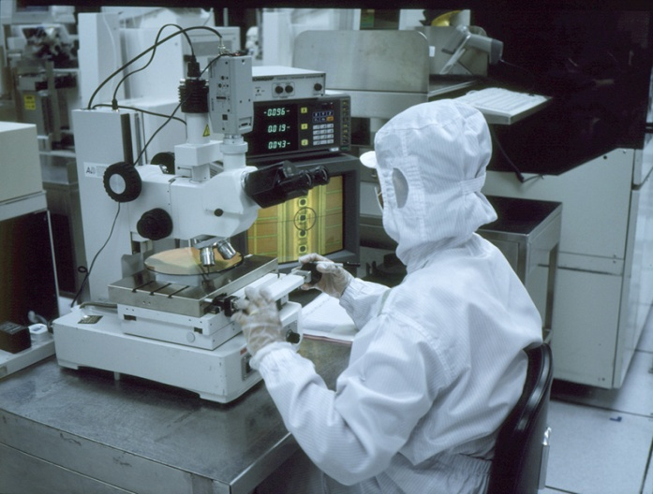
On-Site support for Your Needs
Annual Service; PM; and Support Contracts
Semi-Annual Service and Support Contracts
Per Call Services
Replacement Lasers/Parts

Slide 7
WIS, Inc. has a Large Team of highly qualified former OEM FS Engineers
Customer Tool Requirements
Assigned Engineer
FSE Tool Experience
Customer /FSE Personality
FSE Training
Engineers are Level 3 to Level 5 experience

